Slide 1


CREDIT CARD FRAUD DETECTION

Slide 2

GROUP MEMBERS
T.KEERTHANA
T.PRANATHI
M.VASAVI
N.ARUN
A.ABHINAV
-GROUP 6

Slide 3


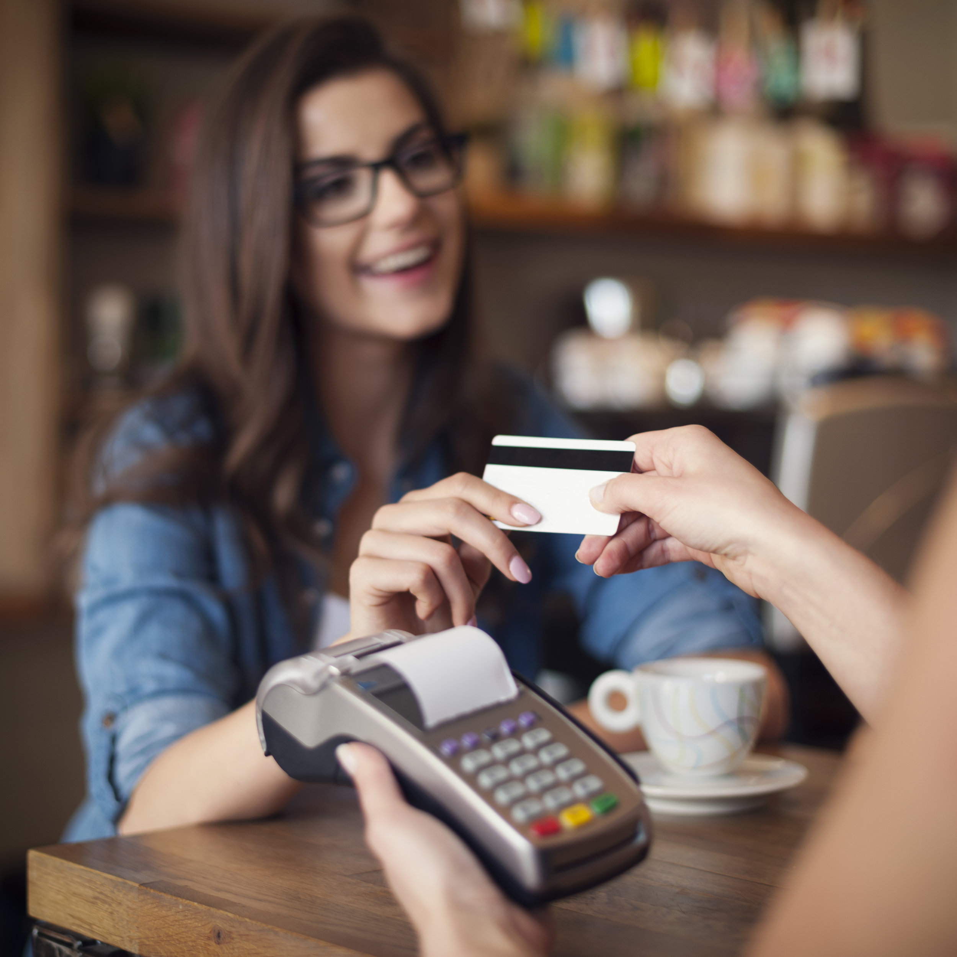
BACKGROUND
In today’s digitalized world, all the transactions are done with either debit card/ credit card.Credit cards are used for purchasing goods and services with the help of virtual card and physical card whereas virtual card for online transaction and physical card for offline transaction.
In a physical-card based purchase , the cardholder presents his card physically to a merchant for making a payment . if the card holder doesn't realize the loss of card, it can lead to a substantial financial loss to the credit card company.in online payment mode, attackers need only little information for doing fraudulent transaction(secure code, card number, expiration date etc..).

Slide 4

Objective :
Our objective is to predict the FRAUDS of a CREDIT CARD based on the remaining attributes of the dataset.
The Path:
The data set is considered to predict frauds of credit card through the parameters like v1-v28, time, amount and class.
For prediction we used algorithms of machine learning named Logistic Regression, Random Forest, KNN
Data set is downloaded from the link:
https://www.kaggle.com/datasets/mlg-ulb/creditcardfraud

Slide 5
Data and Data Quality Check
In this data we have 31 attributes and 28480 observations.
This dataset presents transactions that occurred in two days, where we have 492 frauds out of 284,807 transactions.
This dataset presents transactions that occurred in two days, where we have 492 frauds out of 284,807 transactions. It contains only numerical input variables which are the result of a PCA transformation. Unfortunately, due to confidentiality issues, we cannot provide the original features and more background information about the data. Features V1, V2, … V28 are the principal components obtained with PCA, the only features which have not been transformed with PCA are 'Time' and 'Amount’.
We have 1081 missing values in the dataset .

Slide 6
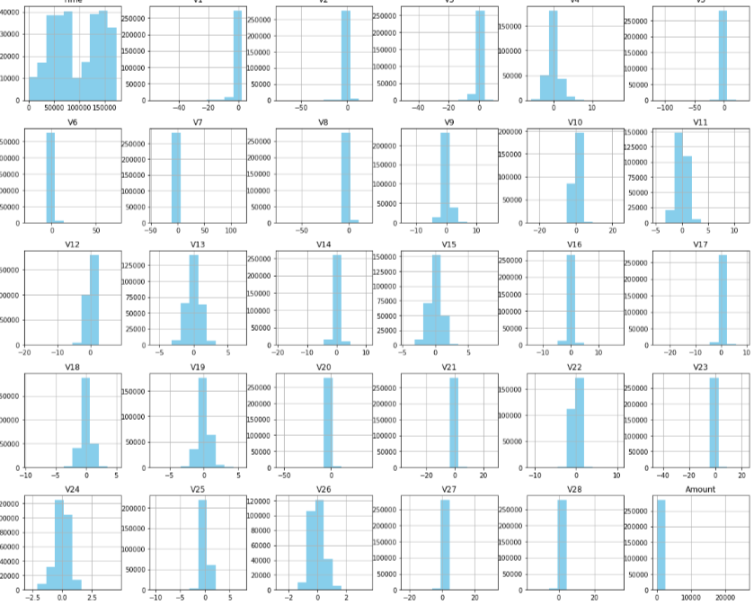
HISTOGRAMS OF EACH ATTRIBUTES

Slide 7
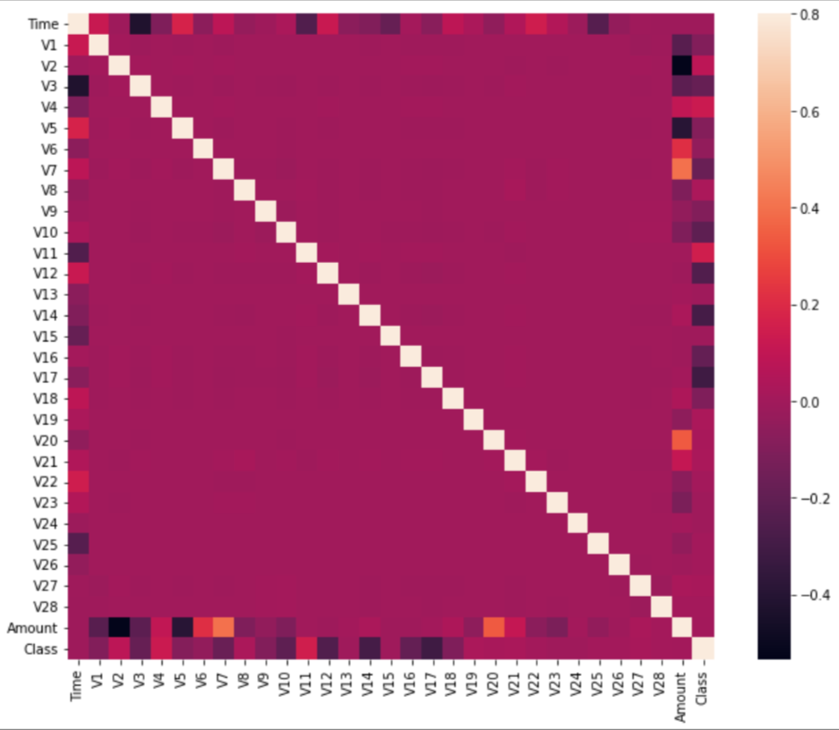
EDA Insights
Correlation check

Slide 8
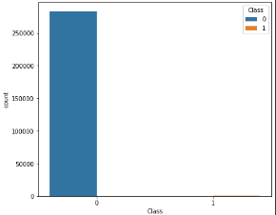
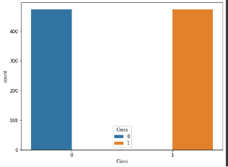
BALANCING THE DATA USING FRAUDS AND NON FRAUDS

Slide 9
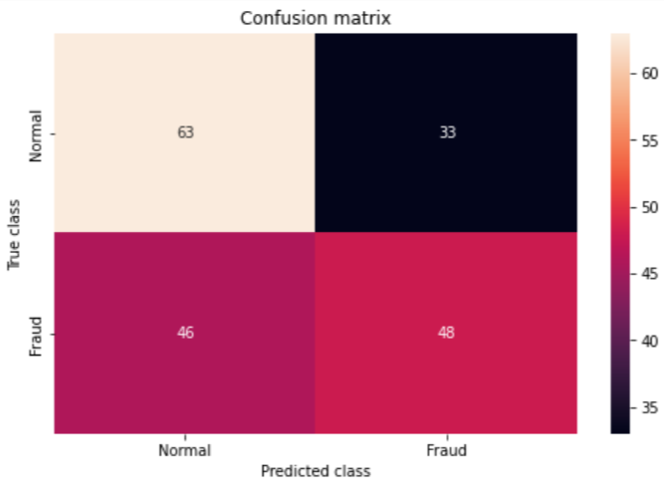
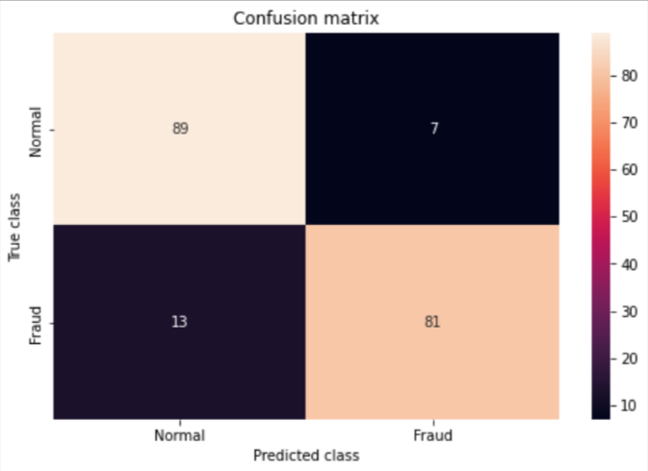
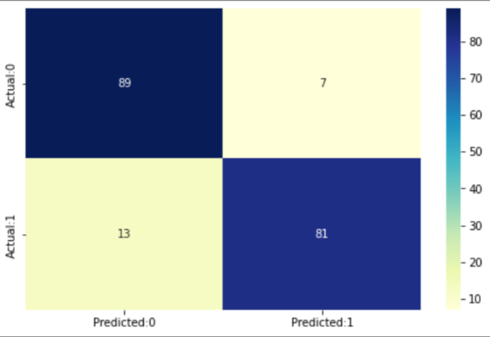
CONFUSION MATRIX
K-Nearest Neighbor
Random Forest
Logistic regression

Slide 10
Model Statistics:
 | PRECISION | RECALL | F1-SCORE | ACCURACY
LOGISTIC REGRESSION | 0.977 | :0.920 | 0.948 | 0.949
RANDOM FOREST | 0.999 | 1.0 | 0.999 | 0.999
KNN | 0.999 | 0.920 | 0.958 | 0.959

Slide 11
Summary & Recommendations :
The dataset contains transactions made by credit cards in September 2013 by European cardholders. This dataset presents transactions that occurred in two days, where we have 492 frauds out of 284,807 transactions.
We were able to find the relationship (either positively correlated or negatively correlated ) between the attributes.
To predict CREDIT CARD Fraud values, Linear Regression ,Random Forest and KNN is being selected.
The best fitted model among three classifications ,obtained is in Random Forest with 96% accuracy.
The basic model has given the maximum accuracy.

Slide 12
CONCLUSIONS
The fraud transaction detection is the major issue of prediction due to a frequent and large number of transactions.
After comparing all the classification algorithms, it is concluded that under various conditions, Random Forest performed best among them. After feature selection and finetuning, the parameters the performance of the models was increased up to 15-20%. For sampling method comparison, Oversampling provided best results compared to SMOTE and undersampling. Sampling methods provided much better results compared to raw data. Comparing all the models under every condition Random Forest performed best for oversampling technique with 0.999 accuracy, precision, recall, and F-1 score.

Slide 13
7 Easy Tips For Credit Card Safety
1 Keep your card with you always
2 Change your PIN regularly 3 Do not share your PIN with anyone 4 Check alerts and your monthly Credit Card statement carefully
6.Don’t click on suspicious links
5 Avoid using your card on suspicious websites or apps
7 Update your bank immediately in case your card is stolen or lost

Slide 14
Thank You
MENTOR:
MRS.K.PARIMALA SUDHIR DIANA
&
AURORA’S DEGREE AND PG COLLEGE

